Slide 1

Design Patterns
LESSON 2
sTRUCTURAL PATTERNS

Slide 2
Classification
Creational patterns provide various object creation mechanisms, which increase flexibility and reuse of existing code.
Singleton, Factory Method, Abstract Factory, Builder, Prototype
Structural patterns explain how to assemble objects and classes into larger structures while keeping these structures flexible and efficient.
Adapter, Bridge, Composite, Decorator, Façade, Flyweight, Proxy
Behavioral patterns handle how objects interact: communication, dependencies, isolation.
Chain of responsibility, Command, Iterator, Mediator, Memento, Observer, State, Strategy, Template Method, Visitor
Creational Patterns
Structural Patterns
Behavioral Patterns
Notes:
Creational = mecanisme de creare a obiectele pentru a oferi flexibilitate si reutilizare a codului
Structural = asamblarea obiectelor si a claselor, integrarea lor structuri mai largi, lasand totusi flexibilitate. Aici o sa fie mai grele exemplele, pentru ca nu o sa lucram pe structuri largi
Behavioral = se refera mai mult la algoritmi si asignarea responsabilitatilor intre obiecte

Slide 3
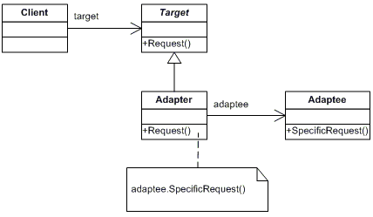
Adapter
Problem: interface incompatibility, legacy code, 3rd party apps that do not fit your interface
Solution: create adapter that makes the conversion between 2 incompatible classes. Target uses a method from Adapter and the Adapter translates that request so that the Adaptee (which is a private field in Adapter) will understand

Slide 4
Adapter in a few words + examples from open-source projects
Identify the 3 actors: Client, Adapter, Adaptee
The adapter does not add functionality! It only allow unrelated classes to work together.
Usually, it is created during the process, because it provides a different interface to a code, that was not originally intended.
When to use it: data from multiple data sources, work with multiple different systems or integrate legacy code in your app
Java: java.util.Collections
C#: System.IO.StreamReader
Backward compatibility with COM objects
https://docs.microsoft.com/en-us/archive/msdn-magazine/2005/july/discovering-the-design-patterns-you-re-already-using-in-net
jQuery: jQuery.fn.css()

Slide 5
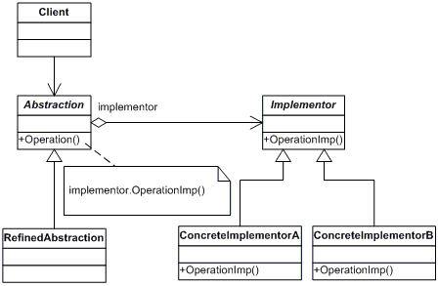
Bridge Separates an object's interface from its implementation so the two can vary independently.
Problem: a lot of subclasses because the objects are composed (red car with diesel engine, blue car with petrol engine, etc.)
Solution: composition. Add field of type B (Implementor) in class A (Abstraction), that will act as a bridge

Slide 6
Bridge in a few words + examples from open-source projects
Identify it by composition
Two pieces that you need to work together, but be independent from one another
Use it when you need different versions of the same system or product,
In contrast to Adapter, you use Bridge upfront, when you start designing. They are similar, but with different intentions
https://www.codeproject.com/Articles/890/Bridge-Pattern-Bridging-the-gap-between-Interface
https://web.mit.edu/java_v1.5.0_22/distrib/share/docs/guide/jdbc/bridge.html

Slide 7
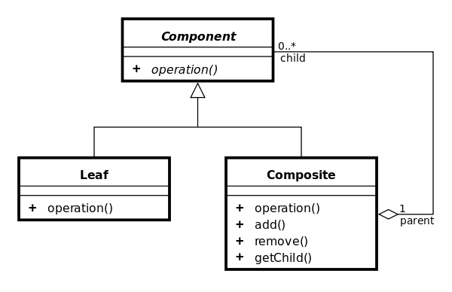
Composite Describes a group of objects that can be treated in the same way a single instance of an object may be
Problem: complex tree representation of your app
Solution: In Client, work only with an interface implemented by leaves and composites.
Have one common method (render, computePrice etc.), Leaf does some work for itself, Composite deals with itself + delegate work to its children
Notes:
The Composite Pattern describes a group of objects that can be treated in the same way a single instance of an object may be.
This allows us to treat both individual objects and compositions in a uniform manner, meaning that the same behavior will be applied regardless of whether we're working with one item or a thousand.
Pitfalls: simplifies too much, it’s difficult to set restrictions because of the unity you have to follow between objects
Composite is different from composition.

Slide 8
Composite in a few words + examples from open-source projects
Works only with a tree structure (hierarchy)
Deal with any object in the same way, regardless it’s a complex or simple object
3 actors: Root (=Component), Composite, Leaf
Composite !== Composition
Example usages in apps: file system, task tracker,
Java: java.awt.Container
C#: System.ComponentModel.IComponent
jQuery: addClass()
React architecture (render method, App as entry point)
VueJS

Slide 9
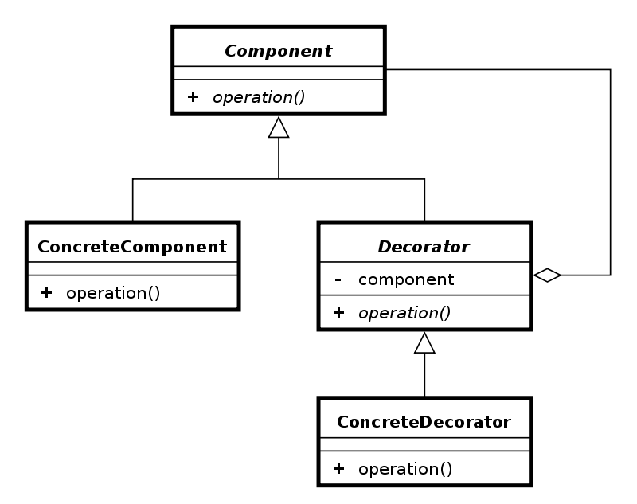
Decorator
Problem: need extra functionality, but don’t want to modify existing classes
Solution: Create wrappers to extend the behavior of an object
Notes:
With the use of decorator, you add functionality to an object, without modifying that object itself.
You can add multiple new functionalities in subclasses. This will respect the single responsibility principle, because each decorator will deal with its own functionality.
It is based on inheritance, but it’s more than the only concept of inheritance.
You will send to the constructor what is decorated (that can be an object or another decorator object).
Just like in composite, you treat the objects in the same way, but you add functionality, you don’t that to have unity between objects.

Slide 10
Decorator in a few words + examples from open-source projects
Wraps an object to add functionality without modifying it
Implement a new class for each functionality you want to add
Often confused with inheritance, but it does not override, but adds/completes behavior
Ideas for your app: compute price (discounts, gift cards, promotions, taxes)
Java: InputStream, UI components in swing, Collection.checkedList
C#: System.IO.Stream
jQuery.extend()
React: Higher Order Components https://reactjs.org/docs/higher-order-components.html
TypeScript decorators (experimental) https://www.typescriptlang.org/docs/handbook/decorators.html

Slide 11
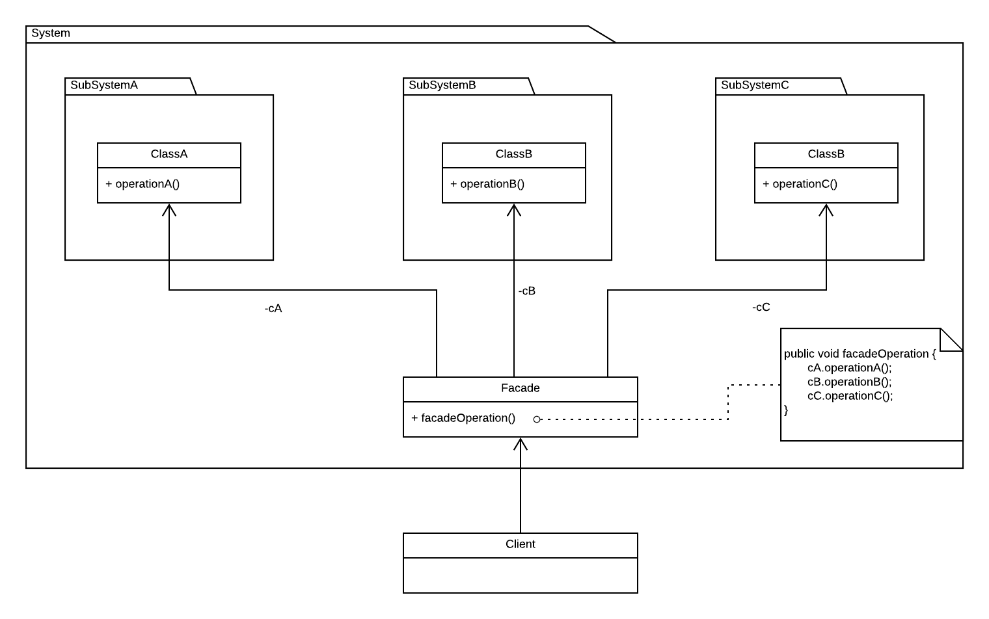
Facade
Problem: poorly designed or complicated system that you need to use in your app
Solution: create an interface (a façade) to allow the client to use the code easier
Notes:
You create a single class that hides the complexity of an entire subsystem.
Think of it as simplifying the API being presented to other developers, something which almost always improves usability.
This gives us the ability to indirectly interact with subsystems in a way that can sometimes be less prone to error than accessing the subsystem directly.
When using the pattern, try to be aware of any performance costs involved and make a call on whether they are worth the level of abstraction offered.

Slide 12
Facade in a few words + examples from open-source projects
Façade is a class that uses composition, because it contains the APIs you’re trying to simplify
Before implementing a façade, see whether you can refactor the system you’re using (if it’s implemented by you, of course)
It’s very simple to implement, so people tend to overuse it, just like with singleton
In contrast with adapter pattern, it does not modify the behavior, it just simplifies usage
Java: java.util.Connection, javax.faces.context.FacesContext
C#: System.Environment, System.String
Retrofit for Android
NgRx for Angular, built on top of RxJS
https://labs.thisdot.co/blog/ngrx-facade-pattern
jQuery: $(element).css(), $(element).animate(), $(document).ready()

Slide 13
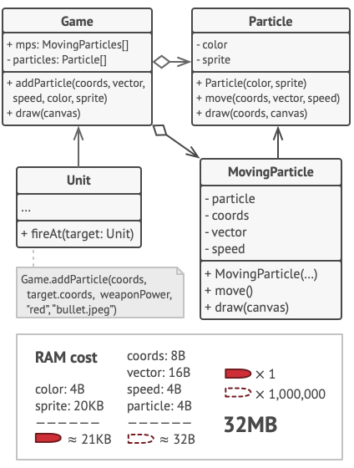
Flyweight is used when a class has many instances, and they can all be controlled identically
Problem: problems with RAM because of keeping a lot of similar objects in memory
Solution: separate state that never changes = immutable (intrinsic state) from state unique to each object, that can be changed by the client (extrinsic state)
Notes:
The Flyweight pattern is a solution for optimizing code that is repetitive, slow and inefficiently shares data.
It aims to minimize the use of memory in an application by sharing as much data as possible with related objects (e.g application configuration, state and so on).
Fun fact: named after the boxing weight class that includes fighters weighing less than 112lb.
In the Flyweight pattern there's a concept of two states - intrinsic and extrinsic. Intrinsic information may be required by internal methods in our objects which they absolutely cannot function without. Extrinsic information can however be removed and stored externally.
Books example (borrows, book specific, borrow specific)

Slide 14
Flyweight in a few words + examples from open-source projects
Flyweight can be recognized by a creation method that returns cached objects instead of creating new ones
Purpose: minimizing memory intake. If you don’t have problems with RAM, there is no point in using it
Caching can be a clue to identify flyweight pattern. Common usage: video games, graphics, but not only
It’s an optimization pattern, not a refactoring pattern.
Java: java.lang.integer.valueOf()
C#: System.StringComparer
Scenario example: on UI (game UI/UX, architecture, landscape design apps, for instance), you have elements like trees, bullets, that only have a coordinate on the screen unique to them, but otherwise they look the same

Slide 15
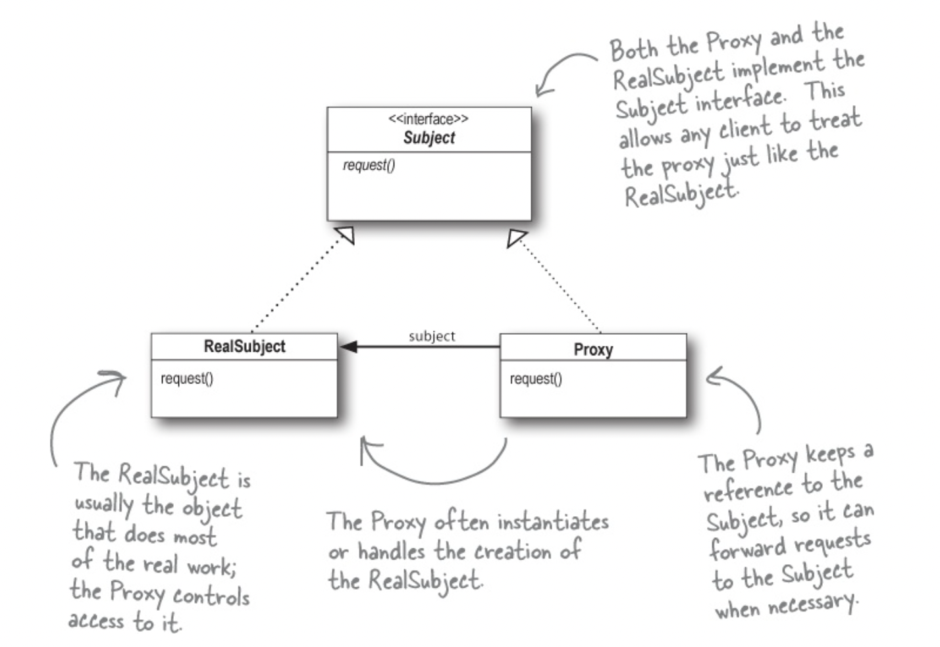
Proxy control and manage access
Problem: object that consumes a lot of resources, but is not always needed, security issues, remote communication
Solution: create an intermediate object (a proxy) that follows the same interface as the service it delegates actions to
Notes:
Use the Proxy Pattern to create a representative object that controls access to another object, which may be remote, expensive to create, or in need of securing.
Provide a substitute/placeholder for another object, something intermediary.
The proxy must follow the same interface as the real service.
Proxy manages the lifecycle of its service, sometimes is sent in constructor, but it’s a rather rare scenario.
You can do this for:
Security reasons (want to check access before executing an operation) -> protection proxy, controls access to a resource based on access rights
Lazy initialization -> virtual proxy, controls access to a resource that is expensive to create
Caching (audio to text example) -> caching proxy
Pass requests over the network -> remote proxy, controls access to a remote object.

Slide 16
Proxy in a few words + examples from open-source projects
Keywords: security, remote, operations with massive costs
Proxy = an intermediate object that intercepts calls and delegates to a real object
Proxy is responsible for the real object lifecycle (unlike decorators, where the object is received)
It can add functionality, but it is not its primary purpose
Java:
java.lang.reflect.InvocationHandler, java.lang.reflect.Proxy
Java RMI (example of remote proxy)
C#:
System.Net.WebClient
System.Runtime.Remoting.Proxies.RealProxy
jQuery.proxy()
JavaScript: Proxy object

Slide 17
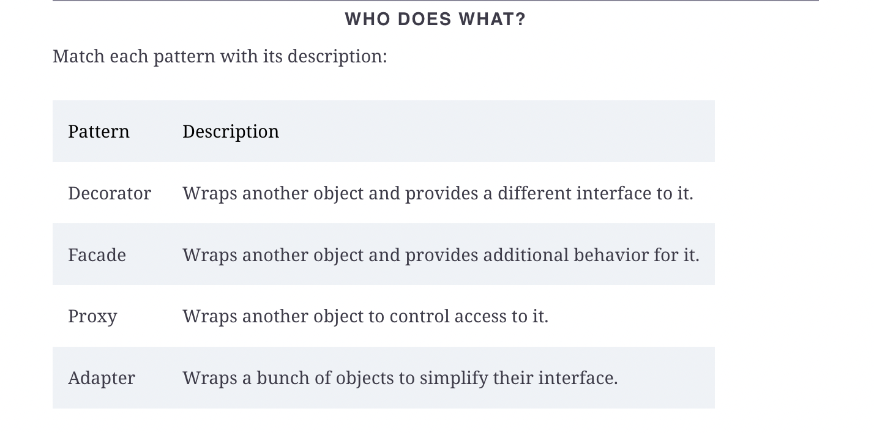

Slide 18
Resources
[INTERNAL]
https://github.com/alexandraturian/food-delivery
https://github.com/alexandraturian/design-patterns
[EXTERNAL]
https://refactoring.guru/
https://addyosmani.com/resources/essentialjsdesignpatterns/book/
https://www.freecodecamp.org/news/tag/design-patterns/
Articles on https://medium.com/

